Slide 1
MM0012 - MM Integration with FI,SD,PP,QM,PM and PS

Slide 2

Workshop Ground Rules
Cell phones off
Full attention throughout
Scheduled Breaks only

Slide 3
MM0012
MM Integration with FI,SD,PP,QM,PM and PS
Materials Management
Sales & distribution
Financial Accounting
Production Planning
Quality Management
Project Systems
SAP- All Modules
Capgemini Public
Notes:
This In-house course was developed to meet the needs of SAP R/3 Consultants working at Capgemini
This course is designed to present a high level view of Materials Management Inventory management and to provide the Consultants with basic information about how to use this Functionality
More in-depth courses have been developed to train Consultants in specific areas discussed during this course
Your comments at the conclusion of this training session are appreciated and will help us better tailor future courses to meet your training needs

Slide 4
MM Integration with FI,SD,PP,QM,PM and PS
PrepareMe
1
2
TellMe
3
ShowMe
4
LetMe
5
HelpMe
Capgemini Public

Slide 5
MM Integration with FI,SD,PP,QM,PM and PS
PrepareMe
1
2
TellMe
3
ShowMe
4
LetMe
5
HelpMe
Capgemini Public

Slide 6
PrepareMe
In SAP Material management, the various data generated are shared and integrated among the other modules
A perfect integration between different business process of a company implies the true power of Supply Chain management
Integration has a cascading effect on all the departments and happens at the same time irrespective of geographical boundaries
A complete and efficient Supply Chain implementation means ,it is able to generate requisition from a sales order, and update G/L a.c while receipt and other business process
Capgemini Public

Slide 7
Purpose
In SAP Material management, the main purpose of integration is that all the divisions of an organization gets the impact
The business flow is maintained via the integration - > interdependencies are being addressed through integration
The main feature of SAP – MM application integration stand out is the capacity of doing it in real time - > which signifies that information is constantly updated
Capgemini Public

Slide 8
Use
The Materials management module is integrated with FI helps in proper G/L postings during various movement of material and also it removes duplicate entry
For deliveries via SD route we need to have integration with SD, where deliveries can be created for Stock Transfer between two plants and then stock can be picked and goods issue can be done
For a subcontracting process Bill of Materials (BOM) helps in planning of components while being exploded for a finished product which has been subcontracted
MM Integration with Quality management process makes it possible for the organization to restrict below graded product either to be accepted or being sold out to customers
In Materials management , procurement can be done based on some Projects ,where the materials procured can be accounted against Work Breakdown Structures (i.e WBS elements )
Maintenance Orders created during routine maintenance can trigger off a procurement process by creation of purchase requisition
Capgemini Public

Slide 9
MM Integration with FI,SD,PP,QM,PM and PS
PrepareMe
1
2
TellMe
3
ShowMe
4
LetMe
5
HelpMe
Capgemini Public

Slide 10
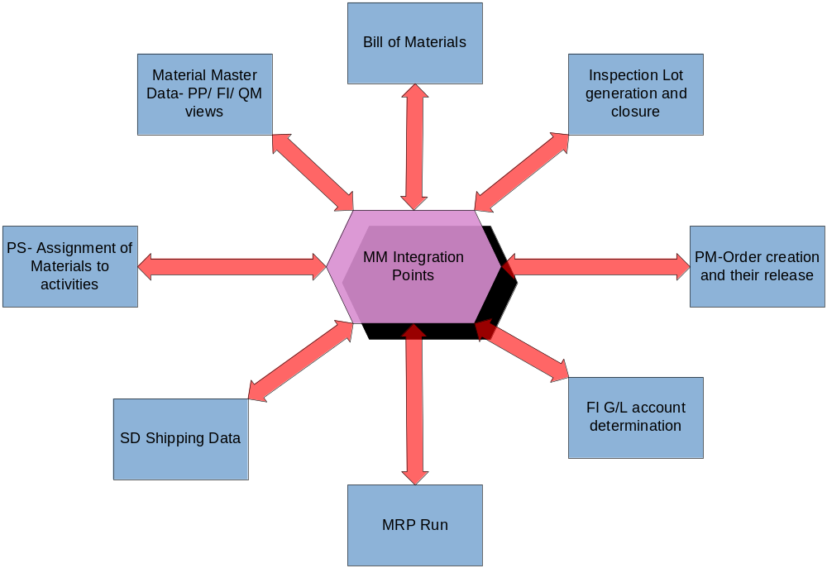
TP – MM Integration aspects
Capgemini Public

Slide 11
TP-MM Integration at a glance
Stock
Transfer
GL
updated
Sales
Order
MRP
Run
Procurement
& Goods
Receipt
Maintenance
Order
PO
Creates PR
Material in
Quality
Delivery
GL updated
Goods
Issue
During Stock transfer between two companies or even two plants located far away
SD Delivery route can be used for Goods Issue
Whenever any Goods movement is done, the FI book is hit , i.e GL a/c gets updated and this is done on a real time basis
A maintenance order when released can be used to create a requisition of a material
Else during Production planning after receiving of Sales Order requisition can be created
Capgemini Public

Slide 12
Material Master
Capgemini Public

Slide 13


TP SD– Master Data Material
For MM –SD integration the following views are required to be maintained
Sales Org Data 1
Sales Org Data 2
Material master Views for SD integration
Capgemini Public
Notes:
Also Basic Data view is required
General item Category field is an important field in Basic Data 1 view
It controls the way deliveries are being created (both inbound or outbound) in case of Goods Movement
In addition to the above views for stockable material, quantity and value updation should be activated for material type settings in customizing

Slide 14
TP FI– Master Data Material
For MM –FI integration the following views are required to be maintained
Accounting 1
Material master Views for FI integration
Capgemini Public
Notes:
Also Basic Data view is required
In Accounting view valuation class is a very important field which actually links FI with MM
In addition to the above views for stockable material, quantity and value updation should be activated for material type settings in customizing

Slide 15
TP PP– Master Data Material
For MM –PP integration the following views are required to be maintained
MRP 1
MRP 2
MRP 3
Material master Views for PP integration
MRP 4
Capgemini Public
Notes:
Also Basic Data view is required
The MRP type is a very important aspect for running of MRP for the material
It signifies what all to consider when MRP is run, and how Purchase requisitions will be created when MRP is run
In addition to the above views for stockable material, quantity and value updation should be activated for material type settings in customizing

Slide 16
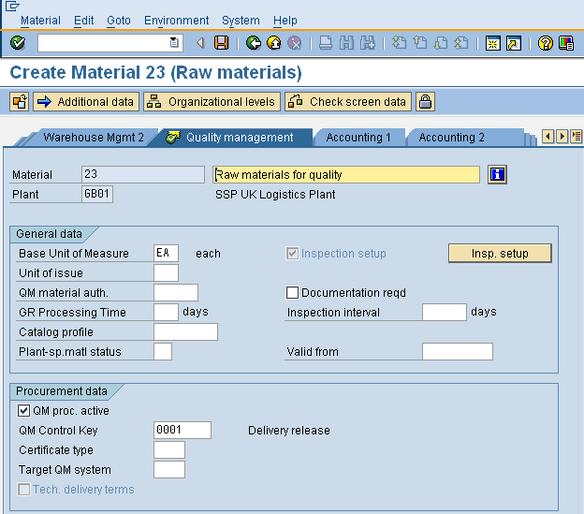
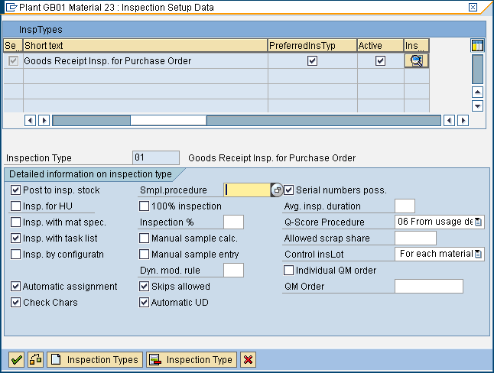
TP QM – Master Data setting
Quality Management View
Activate QM Procurement
Activate Inspection Setup
Require Sampling Procedure
Material master Views for QM integration
Capgemini Public
Notes:
In the QM view of the Material Master the QM procurement key must be checked, QM control key must be configured
Also Insp Setup needs to be maintained , along with sampling procedure– These are although QM configuration steps

Slide 17
MM Integration with FI
Capgemini Public

Slide 18
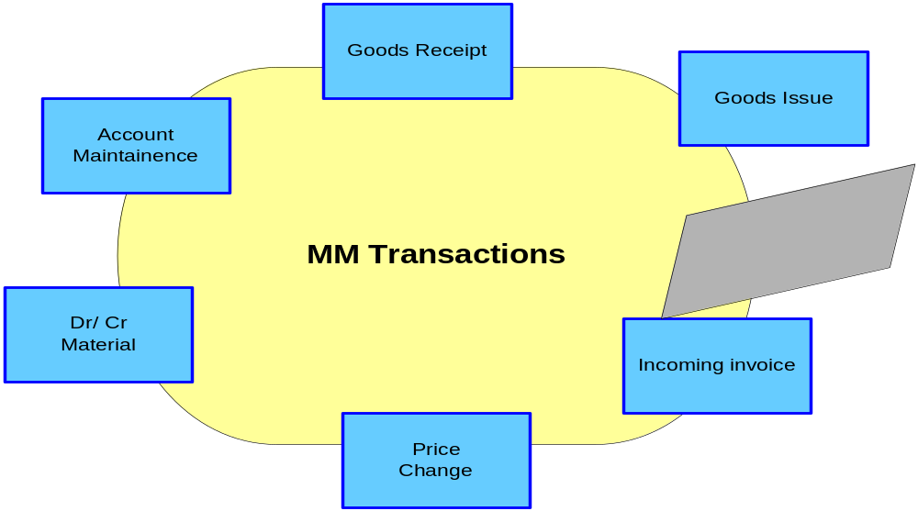
TP FI – Auto A/c Determination
Capgemini Public

Slide 19
TP FI– Valuation Class and G/L
Material master
created with ref to
Material Type
Material Type
Significant
With
Transaction
Keys
Movement
Types
Account
Category Ref
Valuation
Class
Transaction Key+ Val Class (from
Material Master) = G/L A/c
Capgemini Public
Notes:
The above is also called automatic account determination for FI
If the valuation area is a plant , then any addition of value or change in value creates a FI entry for a valuated material
If no value is added or changed and movement is done from one valuation area to other then also FI entry is created

Slide 20
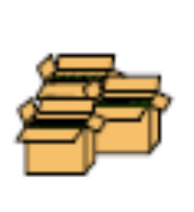
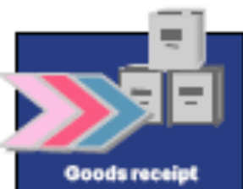

TP – FI Docs creation
Material Document
Accounting Document
Controlling Document
The FI document that is created will contain the
FI GL a/c postings Dr and Cr
The Dr and the Cr should also match.
Capgemini Public
Notes:
If accounting are affected by the material movement, then accounting document is created in addition to the material document as an integration aspect that FI books are also affected

Slide 21
QM Integration
Capgemini Public

Slide 22
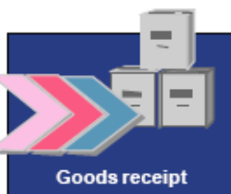


TP QM– Quality Process
Material in Quality
Which Creates an Inspection Lot
Input the results of the Inspection and release Inspection Lot
Vendor
Material Posted in Unrestricted Stock
Warehouse
Whenever a Goods Receipt is being posted for a valuated material whose quality management has been activated the material gets posted to quality stock
Depending upon the inspection plan attached with the material Inspection Lot is created
The quality dept needs to put in the results of the inspection in the inspection lot and release the material from quality
Capgemini Public
Notes:
An inspection lot is being identified with an inspection Lot number – which is usually an Internally generated number and a Inspection Lot creation date

Slide 23
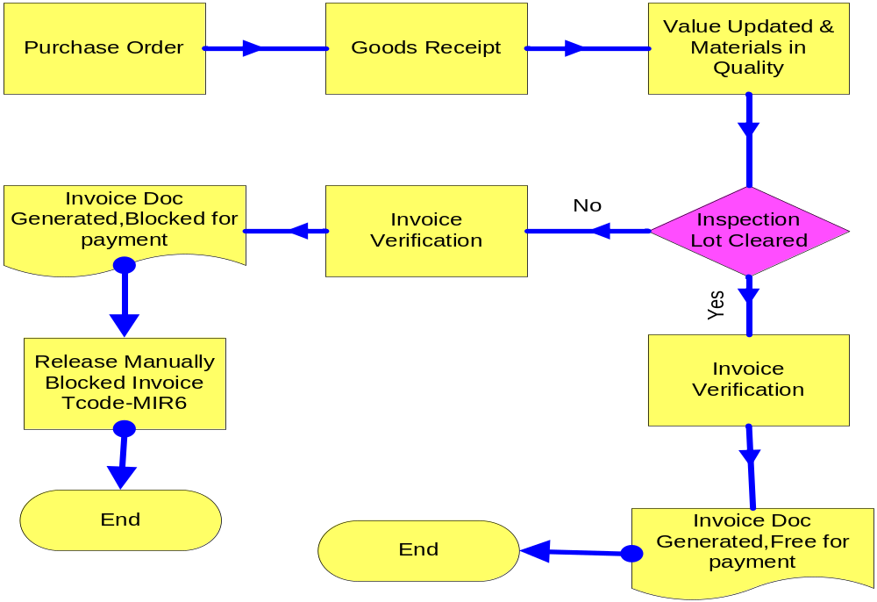
TP QM– Invoice Blocking
If an invoice Verification is carried out for a material in quality then the Invoice will be posted but blocked for quality reasons
Then the user needs to go to transaction ‘MIR6’ and manually release it for payment by FI
Capgemini Public

Slide 24
MM Integration with PP
Capgemini Public

Slide 25
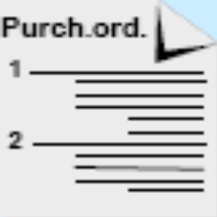
TP PP– BOM (Sub Contracting)
Sent to Subcontractor
BOM
Finished Prod
PO of
Finished prod
After BOM explosion gives rise to demand of raw materials at Plant
Raw Material 1
In subcontracting, your vendor (i.e. the subcontractor) receives components in order to manufacture a refined product for which your company has sent a purchase order
The components the vendor requires to produce the ordered product are listed in the purchase order and provided by you
The components can be defined in the system using a bill of materials
Capgemini Public
Notes:
First Create the Po of the finished product
This finished product has a BOM of its components consists of Raw Materials
Use T.Code – ME2O for displaying SC stock monitoring for vendor , choose Execute
Click on the field under the materials number
Then the components to be supplied will be displayed

Slide 26
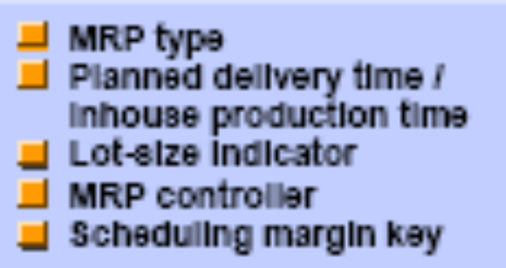
TP PP – MRP Data in Material Master record
MRP Data
MRP data in the material master record can be subdivided into the following categories:
    General data which we must/can always define for a planning material,
    MRP procedure dependent data
    Data required for scheduling,
    Data required for lot-size calculation,
    Data required for storage location MRP.
    MRP data in the material
The procurement type defines whether the material is produced in-house, is procured externally, or
both.
The MRP controller is a person or group responsible for planning material requirements
The MRP type determines whether or how the material is planned.
For ex- the material could be planned using traditional MRP, or it could be planned using reorder point planning.
The lot size key determines the lot-sizing procedure the system uses to calculate the quantity to be
produced or procured. Examples include fixed order quantity, lot-for-lot and period lot sizes.
Capgemini Public

Slide 27
TP PP – MRP Run- types
Planning run (or MRP Run) for one plant online (total planning)
Planning run for one plant - background processing
(total planning)
Planning Run for one material- single item processing
We can execute the planning run on two levels: for an individual material or as a total planning run for a plant
In addition, it is possible to execute a total planning run for several plants and/or MRP areas
We can execute a single -item planning run either for a specific material only (single level) or for all BOM levels (multi level).
A total planning run can be executed online or as a background job.
Total planning for a plant encompasses all materials relevant to MRP for this plant and includes the BOM explosion for materials with BOMs
Capgemini Public

Slide 28
TP PP – MRP Run- Creation indicator
The creation indicator controls the creation of planned orders or purchase requisitions, schedule lines, and MRP lists.
By entering the creation indicator for purchase requisitions in the entry screen of the planning run, we can control whether the system should directly create purchase requisitions or planned orders first.
If a schedule line exists for a material and the source list contains an entry relevant for planning, schedule lines can also be created directly via materials planning.
This is controlled by the creation indicator for schedule lines in the entry screen of the planning run.
The planning results can always be saved in the form of MRP lists.
The creation indicator for MRP lists controls whether the system should always create an MRP list for all planned materials or whether it should create an MRP list for certain materials depending on the exception message.
In total planning, the creation indicator in the entry screen is used for planning if no other plant or MRP group parameters have been maintained for the material.
Capgemini Public

Slide 29
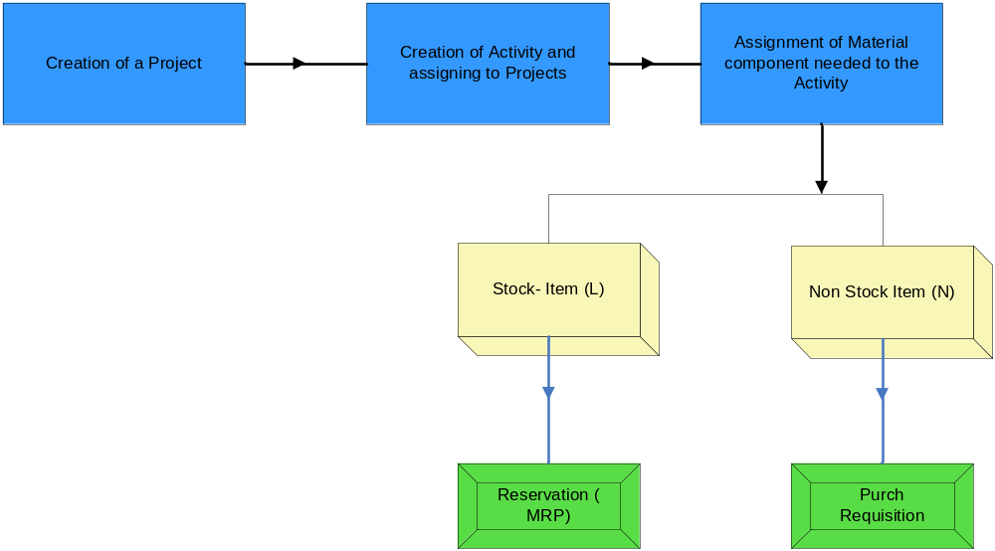
TP PS – Proc of Materials for Project
Capgemini Public
Notes:
For planning of procurement of the material for a particular project, material components are required to be assigned to the activities.
There can be two different types of material- stock items (item category L) and non-stock items (item category N).
Stock items are entered for materials that are valuated and are kept in stock, (warehouse, or project stock), for which reservations or stock requirement list can be generated for stock items.
Non-stock items are entered if materials are to be procured directly for the network (that is, not using MRP).
Purchase requisitions are created for non-stock items and can be directly passed on to purchasing.

Slide 30

TP PM – Procurement via Maint. Plan
Standard Process
Service Entry Sheet
Maintenance Plan
Maintenance Order
Requisition
Purchase
Order
Accelerated Process
Service Entry Sheet
Maintenance Plan
Maintenance Order
Requisition
Service Entry Sheet
Maintenance Plan
Requisition
Service Entry Sheet
Maintenance Plan
Capgemini Public
Notes:
Some services like grass cutting, watering, repairs, preventive cleaning are to be performed on a periodic basis
This can be recorded the service specifications in a maintenance order (application component PM Plant Maintenance) that references a maintenance (servicing) plan.
The processes described under the ‘Standard Process’ above is a basic process cycle.
But in ‘Accelerated Process’ we can have the option of speeding up service procurement by reducing the number of steps to be carried out in the SAP System to a minimum.

Slide 31
MM Integration with FI,SD,PP,QM,PM and PS
PrepareMe
1
2
TellMe
3
ShowMe
4
LetMe
5
HelpMe
Capgemini Public

Slide 32
Shipping Point
Capgemini Public

Slide 33
TP SD – Shipping Point
Shipping
Condition
Loading
Group
Plant
Shipping Point
The Shipping point is required for creation of deliveries.
The supplying plant is to be treated as a customer and a customer code should exist with the same code as that of the Plant.
The SAP system automatically determines the shipping point during creation of an Inbound or an Outbound delivery
Capgemini Public

Slide 34
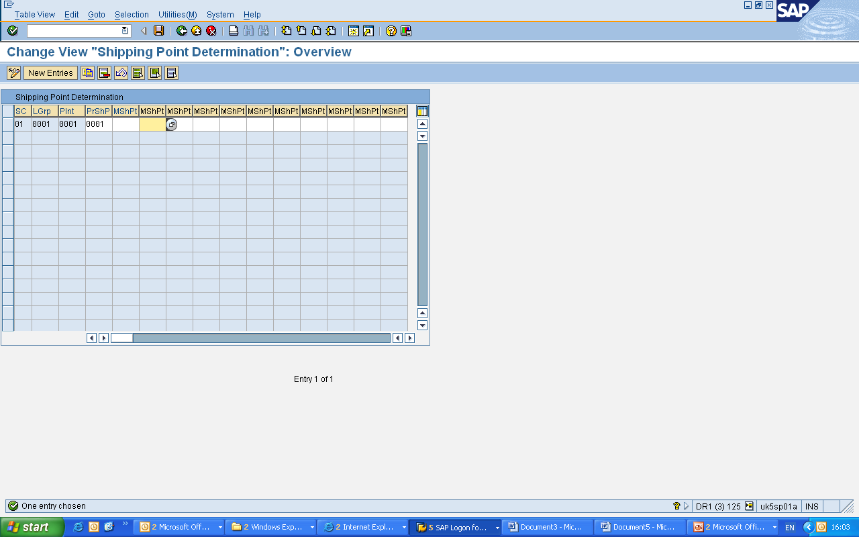
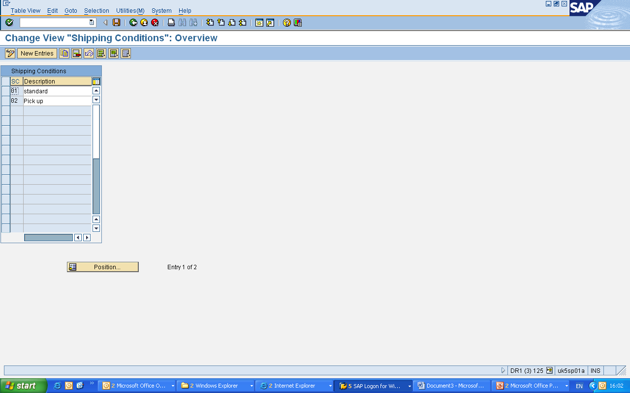
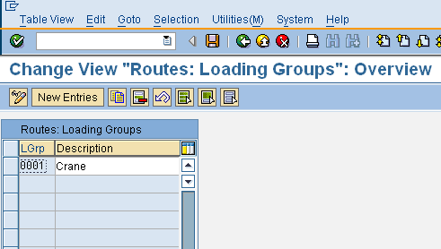
TP SD– Shipping Point Configuration
Logistics Execution → Shipping → Basic Shipping functions → Shipping Point and Goods Receiving Determination
For Shipping Condition Configuration go to ‘Define Shipping Conditions’
For Loading Group Configuration go to ‘Define Loading Groups’
For Shipping Conditions go to ‘Assign Shipping points’
Capgemini Public
Notes:
The Loading group is defined in Sales Data view of the material master.

Slide 35
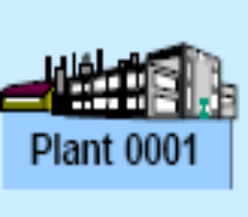
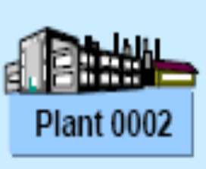


TP SD – Stock Transfers- SD Route
Create
Delivery
Via
SD Route
Unrestricted Stock
Goods Issue
Goods Receipt
Unrestricted Stock
This type of transfer always takes place from a plant to another plant.
After the stock transfer order is created then SD outbound delivery is created, based on the Shipping Points configuration
Goods issue is being done from the despatching plant- Movement type 641
Material and accounting document is generated as because there is change in valuation.
Capgemini Public
Notes:
This process starts only after the issuing/ despatching plant receives a Purchase order from the receiving plant.
The issuing/ despatching plant then creates a outbound delivery
The outbound delivery is then used for ‘Picking’ if picking has been activated for the Plant
The issuing/ despatching plant then issues the material from its unrestricted use stock, against that PO.
Movement type 351 is generally used.
These types of Purchase Orders are usually called ‘Stock Transport Order’
The receiving plant has to be maintained as a Customer

Slide 36
Auto A/c Determination
Capgemini Public

Slide 37
TP FI – Influencing Factors
Client | Chart of Account | Transaction Key | Valuation Modifier | Account Group | V Class | G/L Dr | G/L Cr
125 | CAIN | BSX | 0001 |  | 3000 | 300000 | 300000
125 | CAIN | WRX | 0001 |  | 3000 | 191100 | 191100
125 | CAIN | PRD | 0001 |  | 3000 | 231000 | 281000
125 | CAIN | GBB | 0001 | VBR | 3000 | 400000 | 400000
The Influencing factors for auto account determination is-
  Chart of Account
  Transaction Key
  Valuation Modifier
  Account Grouping Code
  Valuation Class

Slide 38
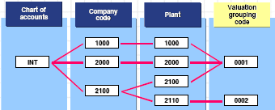
TP FI – Influencing Factors – Val Grouping Code
Valuation Area=Plant
This is a key for account determination that enables a differentiation for G/L account assignment by valuation area within a chart of accounts
By activating or deactivating the valuation grouping codes, we can turn on or off the dependency of the account determination function on the valuation area
If Valuation grouping code has been activated, you must assign a code (any code) to each valuation area
You must configure automatic account determination separately for each valuation grouping code within a Chart of Account
Capgemini Public

Slide 39
TP FI – Influencing Factors- Transaction Key & A/c Grouping Code
Account Grouping
Key for account determination that enables a G/L account assignment differentiation for the offsetting entry for an inventory posting (transaction BSX) and possibly other transactions
Depending on the movement type and the special stock indicator, you can assign an account grouping (any account grouping) for individual transactions (such as GBB, PRD, ...)
Transaction Key
Key for account determination that symbolizes the business transaction
Posting transactions for MM are fixed. We use the transaction key to control if the SAP System is to make a posting to a stock account, a price difference account, a GR/IR clearing account, and so on.
Based on the Movement types this transaction key is determined
Capgemini Public
Notes:
Since we use the posting transaction Offsetting entry for inventory posting for various transactions (such as goods issue, scrap, physical inventory), and these transactions should be assigned to different accounts (such as consumption accounts, scrap accounts, expense/revenue from physical inventory differences), it is essential to subdivide the posting transaction according to another key - the account grouping code
Account grouping is a key that allows us to subdivide number assignments for each transaction key in account determination
In Materials Management in the standard system, account grouping is only active for transaction key GGB (Offsetting entry for inventory posting).
We assign an account grouping to each movement type in Inventory Management that uses the posting transaction Offsetting entry for inventory posting.
As well as the Offsetting entry for inventory posting, we can also use account grouping for other transactions (such as price differences) for further differentiation of account number assignments depending on the movement type, if required in the company.

Slide 40
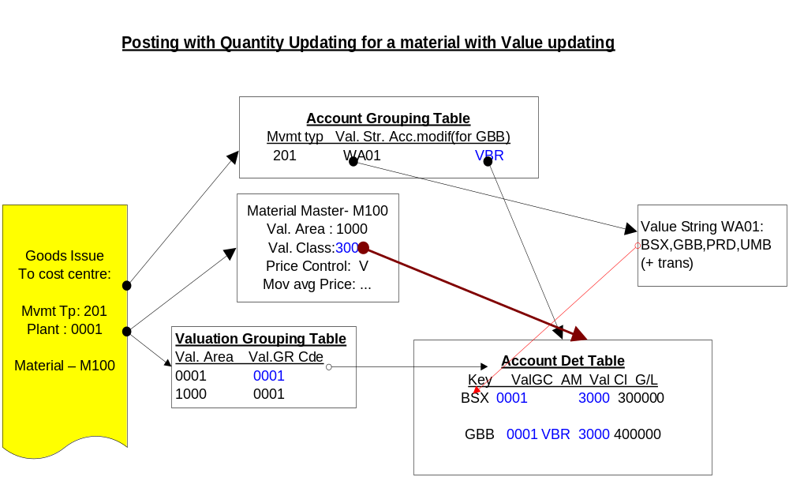
TP FI – Auto A/c Determination an Example
Capgemini Public

Slide 41
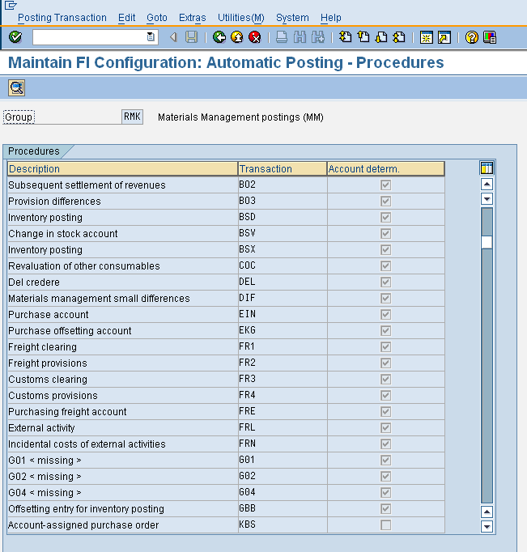
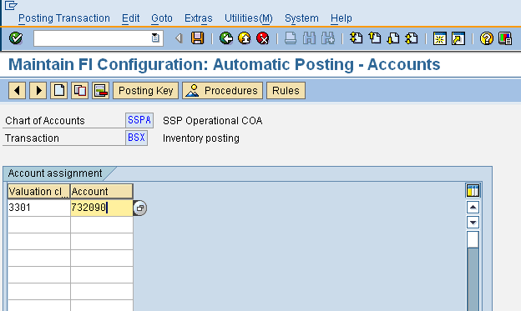
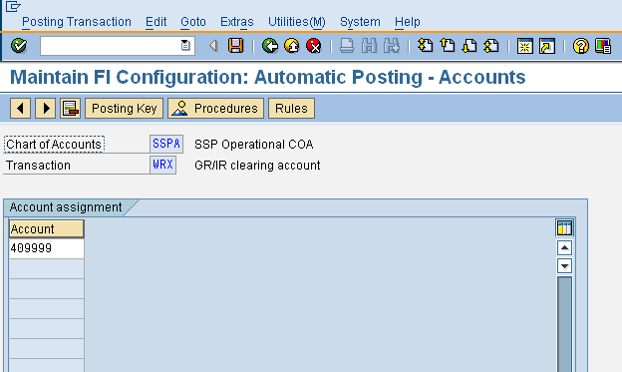
TP FI– Auto A/c Determination
Materials Management → Valuation and Account Assignment → Account determination without wizard → Configure Automatic Postings
For stock postings
  Maintain the corresponding G/L a/cs for transaction key ‘BSX’
  Maintain the corresponding G/Ls for transaction key ‘WRX’
Capgemini Public
Notes:
Here we can also change the Rules for a particular Transaction Key.
Following options are usually allowable for changing of rules-
Dr/Cr
Valuation Modifier
Valuation Class
For offset accounts for transaction key ‘GBB’, there is another option of General Modifier

Slide 42
BOM and MRP Run
Capgemini Public

Slide 43
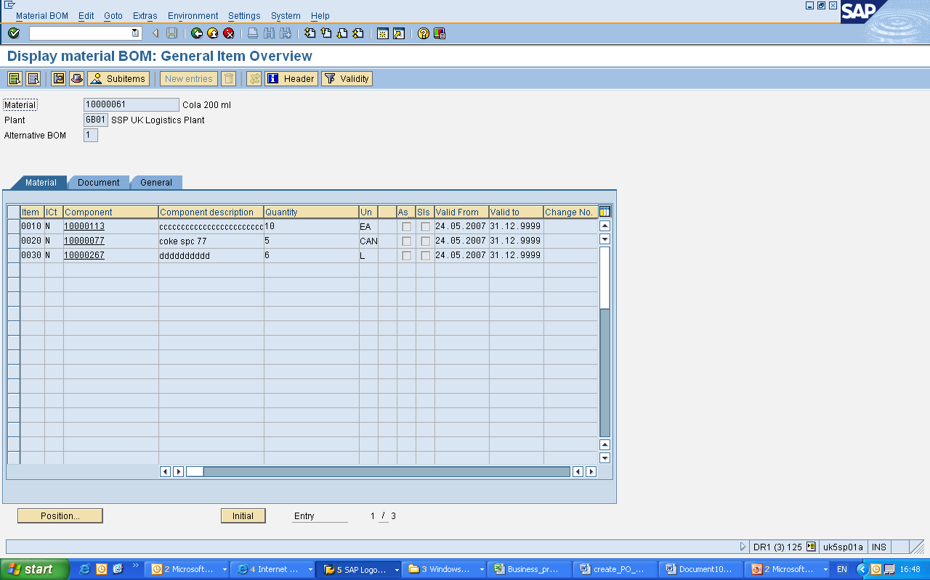
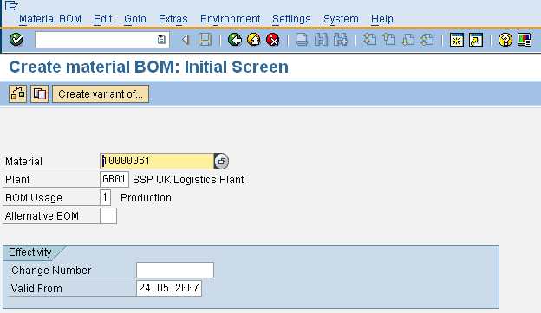
TP PP– Bill of Materials
Menu path: Logistics -> Production -> Master Data -> Bills of Material -> Bill of Material -> Material BOM -> Display
TCODE : CS03
For creation it is CS01
BOM
Finished Prod
Raw Material 1
Capgemini Public

Slide 44
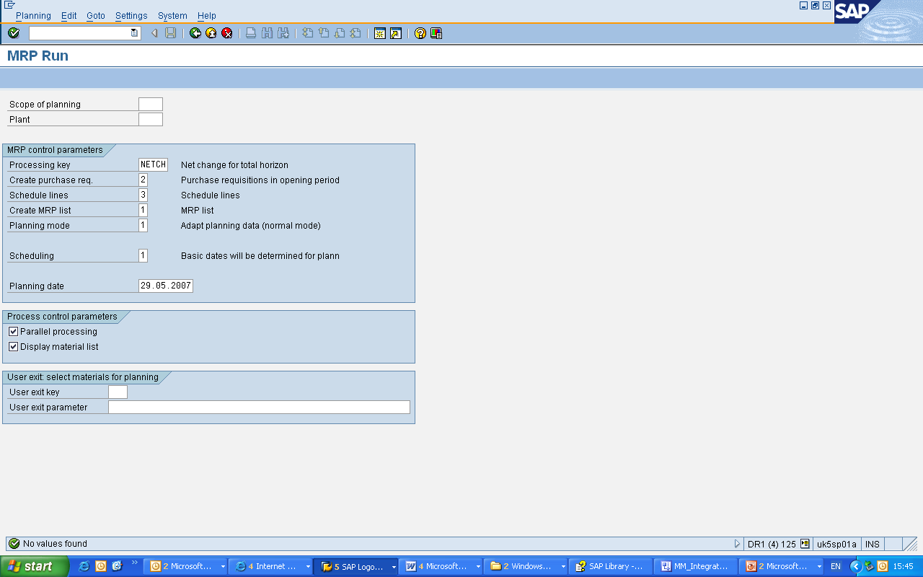
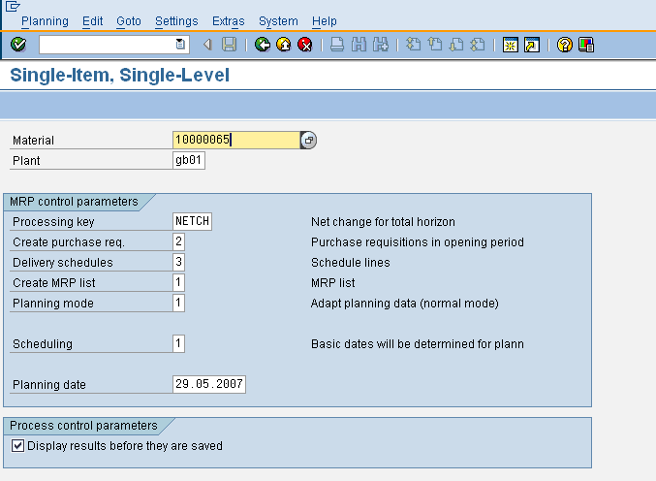
TP PP – MRP Run
Logistics ->Materials Management ->Materials Requirement Planning ->MRP->Planning-> Total planning
TCode- MD01 for Online planning
TCode – MD03 for Single Item Single Level
Capgemini Public
Notes:
Whenever a MRP Run is being carried out, the output depending on settings can be a Purchase Requisition.
This Purchase requisition so created under MRP run can be used for starting the procurement cycle.

Slide 45
MM Integration with FI,SD,PP,QM,PM and PS
PrepareMe
1
2
TellMe
3
ShowMe
4
LetMe
5
HelpMe
Capgemini Public

Slide 46
Let me
Case Study
ABC Corporation has business setup in UK and India with its head quarter
based in London.
It is in the business of manufacturing fast moving Food products, and has a very highly sophisticated warehouse, where all its products are being stored.
Its plant is located in London, and Glasgow in Scotland ,and the management is setting up a new machinery as a part of its modernizing program in Glasgow. They have a quality setup in both the plants .
Do the following-
Create a material master for chicken legs ( for material Type ROH), such that it contains, basic Data, Purchasing, General Storage, Quality management, Accounting and Costing view
Update Initial Stock of 100 KG. Check the material and accounting documents generated
Create a PO for London plant 2000 KG, and then receive the material in two steps of 1000 Kgs each in quality. Check how many Inspection Lots will be created
Check the Inspection Lot of a quantity of 1000 KGs and clear it and then give a usage decision.
Check the stock overview, and after the material is released from quality check the stock overview
The supplier has sent his invoice of 2000 Kgs and the Finance department clears the total invoice.
Check the blocked invoices list if any invoices has been blocked, and what is the reason of blocking it
The Glasgow plant immediately requires 500KG, since it has run a stock out situation and its supplier will take another 10 days to deliver, due to some problem in his yard. Hence its has requested its London plant to send a stock of 500 KG.
Capgemini Public

Slide 47
Let me
Do the following-
Extend the material chicken legs for Glasgow plant and maintain Shipping point configuration for the plants and create customer codes for the plants
Create a Stock Transport order, where the supplier plant is London plant and receiver plant is Glasglow plant. Note down the PO No.. Check the ‘Shipping Conditions Tab’
Use this PO Number to create an outbound delivery number
From the Outbound delivery do a Goods issue to ‘Stock-in-Transit’
Check the material document and accounting document so generated.
Check also the movement type used.
The Glasglow plant has now received the consignment next day, but it has found that one crate containing 10KG seems damaged
Receive 10 KG in GR blocked stock and the rest in quality stock
The organization has now put in place a maintenance plan for all the equipments
Create maintenance order for materials and also for services
From that create service entry sheet
For the new plant at Glasglow, the organization has decided to build up a Turbine setup.
Create a Project Builder and assign the components to the projects.
Create reservation for the stock items and issue the material from stock based on the reservation number.
Create P Requisitions for non stock bale items
Capgemini Public

Slide 48
MM Integration with FI,SD,PP,QM,PM and PS
PrepareMe
1
2
TellMe
3
ShowMe
4
LetMe
5
HelpMe
Capgemini Public

Slide 49
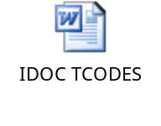
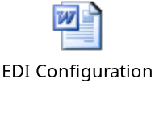
Additional Information
In most of the project now a days companies work on interfaces
It means that some data will be flowing out of the system and some data will be flowing in the system
SAP uses XI- component to interface with the outside system
XI lands those information in an electronic form into SAP as ‘IDOCs’
Hence it is pertinent to know that what are IDOCs, what are message types and what are IDOC partner profiles.
The enclosed document gives a brief introduction to IDOCs and what are the transaction codes that are commonly used for IDOCs.
IDOC menu can be called in SAP by using TCode- ‘WEDI’
Capgemini Public

